Slide 1
DIFFERENT ENTERPRISE
And their features

Slide 2
What is an ERP?
Enterprise Resource Planning (ERP) software systems are used by companies to oversee, customize and automate time-consuming daily activities.
This includes business needs such as:
Financial management Human resources Project management Sales orders Warehouse management Supply chains Sales volume Risk management Inventory management

Slide 3
Who uses ERP?
Any business or organization in need of managing time-consuming daily activities in one place will benefit from ERP solutions – this includes mid-market and small businesses.
Here are some examples of industries that use ERPs: Healthcare Manufacturing companies Small businesses E-commerce Non-profit organizations

Slide 4
Real Examples of Large Companies Using ERP
There are some companies who are using ERPS
Amazon.
Starbucks.
Toyota.

Slide 5
AMAZON
Amazon uses an ERP software called Systems Analysis and Program Development (SAP).
Now SAP business customers can manage their Finances Logistical business needs Human resources Order management Sales
SAP S/4Hana Cloud is the most modern version of SAP ERP with built-in AI, machine learning, and advanced analytics.

Slide 6
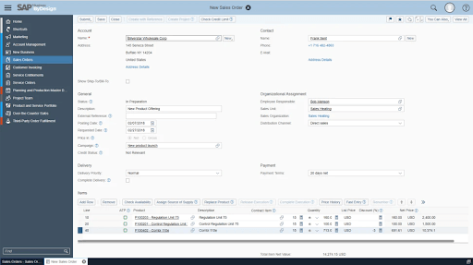
On the left, a menu allows users to choose which area of business they’d like to view – from marketing to third-party order fulfillment, all aspects of the business are provided

Slide 7
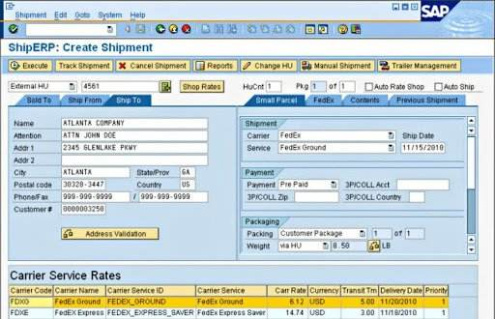
Here’s an example of a SAP ERP with a focus on shipment: This customized solution provides shipment details, a tracking tool, and the ability to view reports.

Slide 8
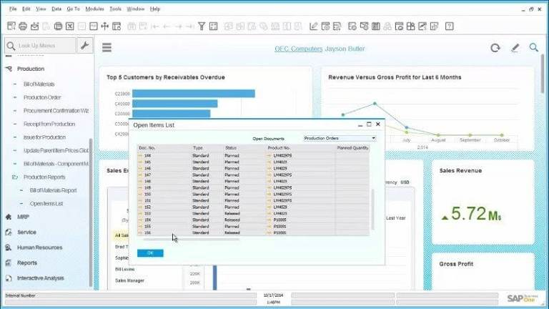
SAP ERP interface. This customized solution provides shipment details, a tracking tool, and the ability to view reports.

Slide 9
Starbucks
Starbucks uses Oracle ERP – a cloud-based software solution used to automate back-office processes and day-to-day business activities. It’s a business management software suite that includes financial management, supply chain management, project management, accounting, and procurement.
Oracle E-Business Suite provides users applications for customer relationship management (CRM), enterprise resource planning (ERP) and supply chain management (SCM) processes.
The Oracle ERP above shows revenue analyses and includes information you need to know at-a-glance including: Revenue Expenses Sales data Inventory management Operations updates

Slide 10
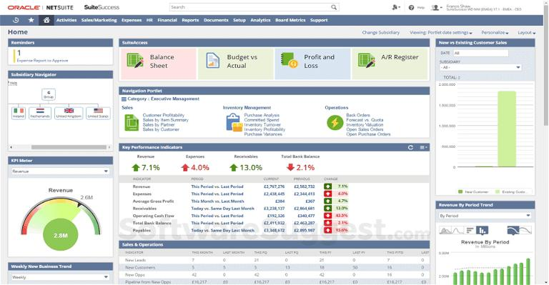
Oracle ERP dashboard: it demonstrates the way you’re able to have all business needs listed in a Navigator section, allowing users to view all areas of a business on one screen: Oracle ERP allows the user to view all areas of a business on one screen and includes identifying information.

Slide 11
Toyota:-
Toyota Industries Corporation is Toyota’s head company. It wanted to expand its reach globally to offer high-quality services like improved operational management accuracy, a paperless system, reduction of work hours, and increase in overall efficiency.
So, Toyota chose Microsoft Dynamics 365 for the job. Dynamics helps manage the after-sales service skills and operations for distributors offering services to their products to customers all over the world

Slide 12
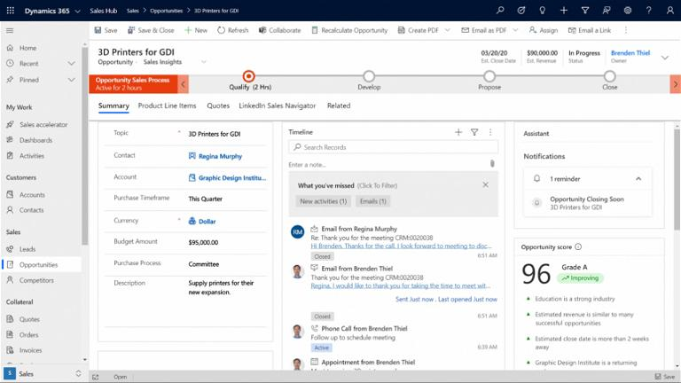
Dynamics ERP:- This section allows the company to view budget information, opportunities for sales, and timelines. Dynamics ERP provides a user dashboard to view multiple areas of business at once.

Slide 13
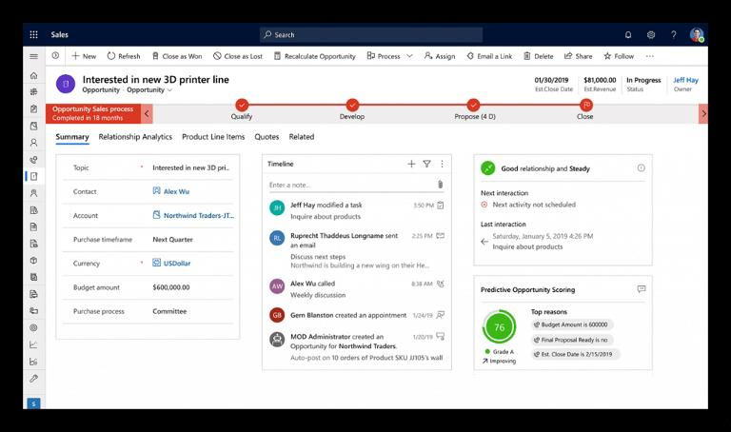
Dynamics ERP sales page:- notice the ability to create a timeline of events and a customer relationship rating.

